Slide 1
Molecular Dynamic Simulation Of Multiheaded Surfactants
Suman Kalyan Samanta
Dept. of Organic Chemistry
Indian Institute of Science
Bangalore

Slide 2
Introduction
Importance of doing Molecular Dynamic Simulation on surfactants
Literature background
MD simulation of Anionic Surfactant
MD simulation of Cationic Surfactant
Our work
Conclusion

Slide 3
Molecular Dynamic Simulation of Anionic Surfactant
Sodium octanoate is taken as the surfactant due to its moderately high CMC value.
Such studies can provide interesting insights into the structure of the aggregates,
Experiment indicates small aggregates found in dilute solutions, like just above the CMC, whereas concentrated solutions have larger aggregates.
A typical surfactant forms micelles in very dilute solutions but the medium-chain surfactant sodium octanoateforms small micelles at a rather high CMC value (ca. 0.4 mol/L). Thus sodium octanoate may be regarded as an adequate model system for theoretical investigations.

Slide 4
System Setup
The system consists of three micelles and free octanoate anions and its structural evolution over a 20 ns simulation to obtain the role of micelle size
or micelle–micelle and micelle–monomer interactions.
Experimental evidence suggests that in 1.0 mol/L solutions of sodium octanoate there should be octanoate molecules in micelles and as free monomers in the ratio of 3:1.
So a model system with three micelles and 15 free monomers was
Assembled to get the account for interactions between different micelles and also between micelles and free surfactant molecules.

Slide 5
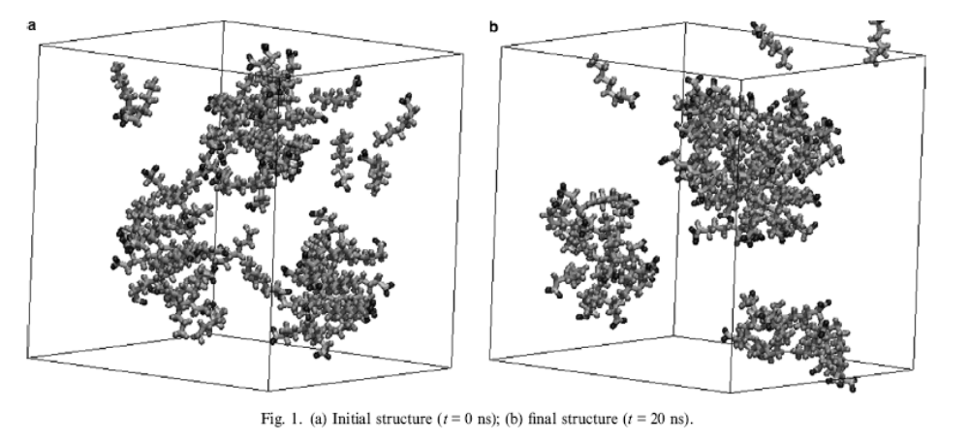
Fig.(a) Initial structure (t = 0 ns); (b) final structure (t = 20 ns).

Slide 6
Theoretical Parameters
The model system consisted of 60 octanoate anions and 60 sodium counter ions, surrounded by 3300 water molecules were taken.
All molecules and aggregates were randomly rotated and randomly placed into the box to avoiding strong repulsive contacts.
The interactions were cut off at 1.5 nm, using the particle mesh Ewald method to treat the long-range electrostatic potential beyond cutoff distance.
Simulations were performed using GROMACS software (version 3.1)
The weak coupling scheme was used for the temperature (300 K,taoT = 0.1 ps) and the pressure (1 bar, tao P = 1.0 ps), coupling octanoate, sodium and water molecules to three separate heat baths.
The trajectory was integrated up to 20 ns using a time step of 1.0 fs and the neighbor list was updated every tenth step.

Slide 7
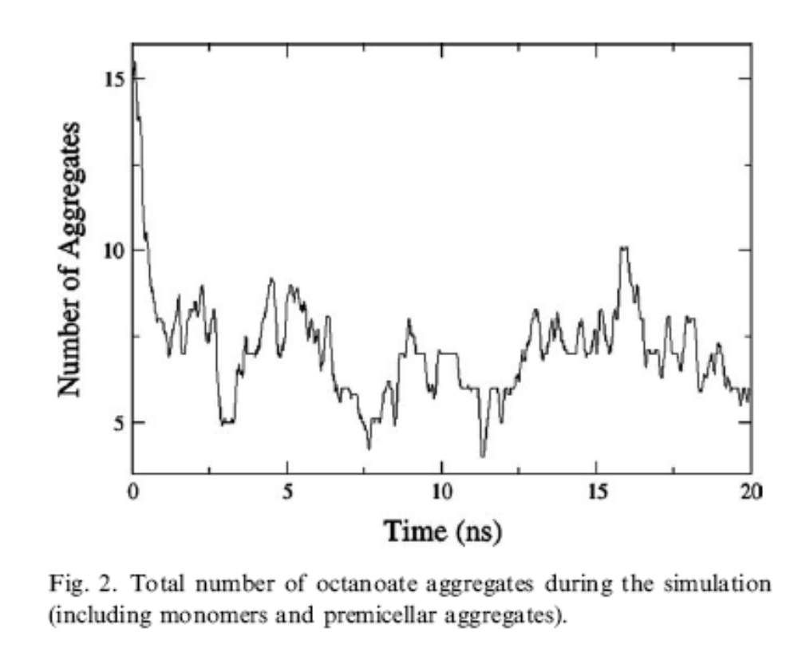
Results
At the end of the 20 ns trajectory the system still contained three micellar aggregates, although the number of free monomers decreased.
It was found that the number of octanoate clusters decreased steadily during the first 2 ns and then reached an average value of ca. 7

Slide 8
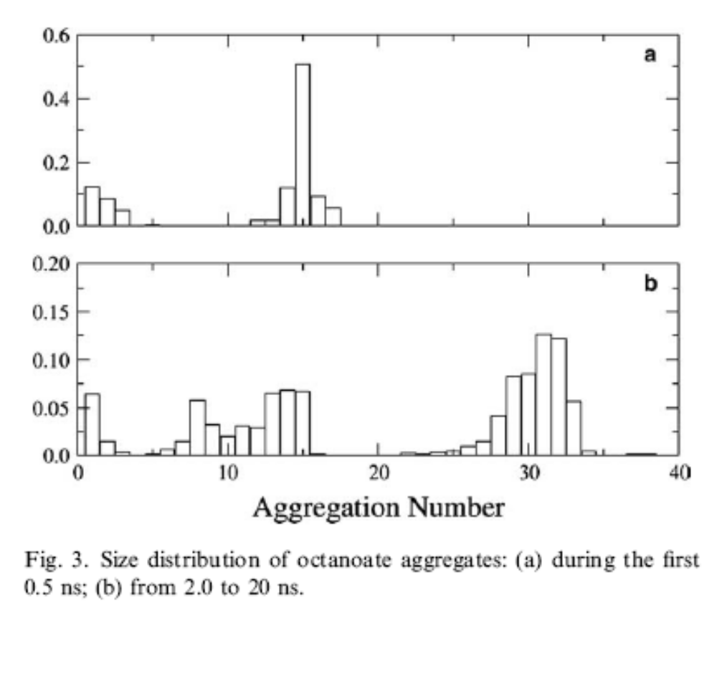
Two populations could be distinguished during the first 0.5 ns, one composed of monomers and small aggregates (N ≤ 5) and the other of micelles with an average aggregation number N = 15.
As the simulation proceeded free surfactant molecules and small aggregates are still present, but large clusters (N ≈30) along with smaller aggregates (N = 6–20) begin to form.

Slide 9
Graphical visualization demonstrated thata larger aggregate began to be formed at ca. 600 ps due to the fusion of two micelles and these are stable.
The third micelle broken into smaller cluster during the process.
At the same time, the free monomers also began to associate into small aggregates and all these small clusters eventually formed new micelles,
though the micelle breaking and forming continued.
A clear indication that a large structural rearrangement occurred in the first 2 ns of the simulation, characterized by an increase in the average values of the aggregation number.

Slide 10
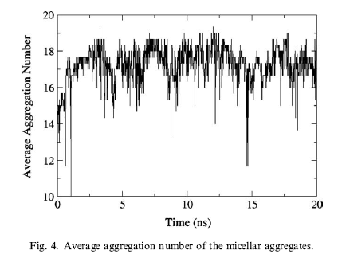

Slide 11
The average micelle radius between 2 and 20 ns was 1.18 ± 0.06 nm while the average aggregation number was 17 ± 1. These values are in good agreement with the experimental (SANS) data.
The micelle size distribution changed over the course of the simulation due to the exchange of monomers, which led lead to the presence of both small and large aggregates.
The average micelle size obtained is in agreement with experimental results.
these result indicate that larger clusters are stable in the nanosecond
regime but smaller aggregates are continually being formed and broken in this time scale.

Slide 12
Conclusions
Two conclusions seem to be well grounded:
Firstly, free monomers are not stable, they tend to associate into micelles or small clusters.
Secondly, small aggregates are short-lived when compared to larger clusters, they will either associate to form a small micelle or break up.

Slide 13
Our Work

Slide 14
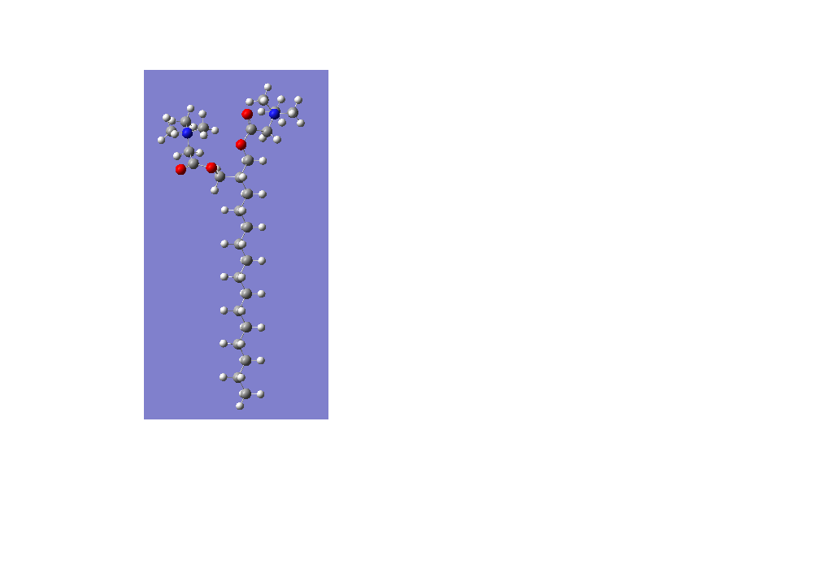
C_H
C_T
C_T
C_T
C_T
Course grained model for 2 Headed surfactant

Slide 15
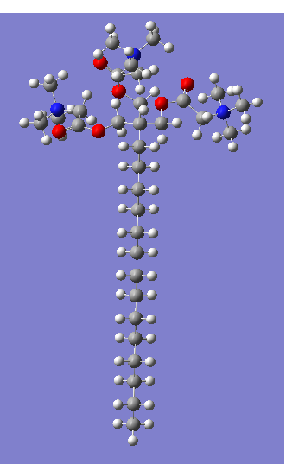
C_H
C_T
C_T
C_T
Course grained model for 3 Headed surfactant
C_T

Slide 16
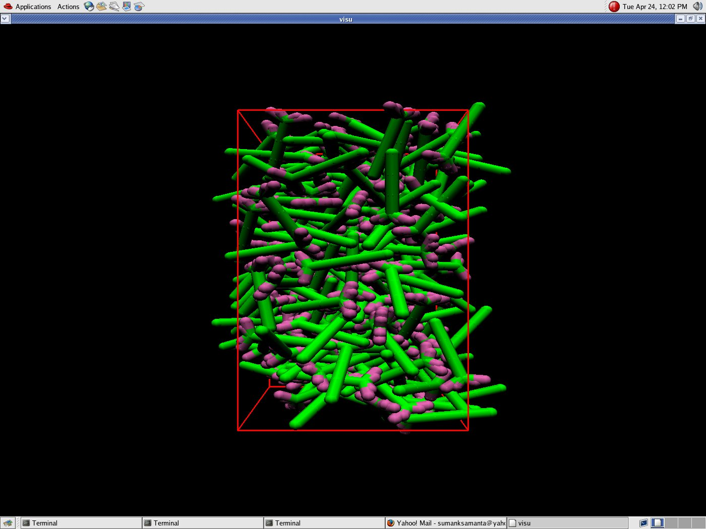
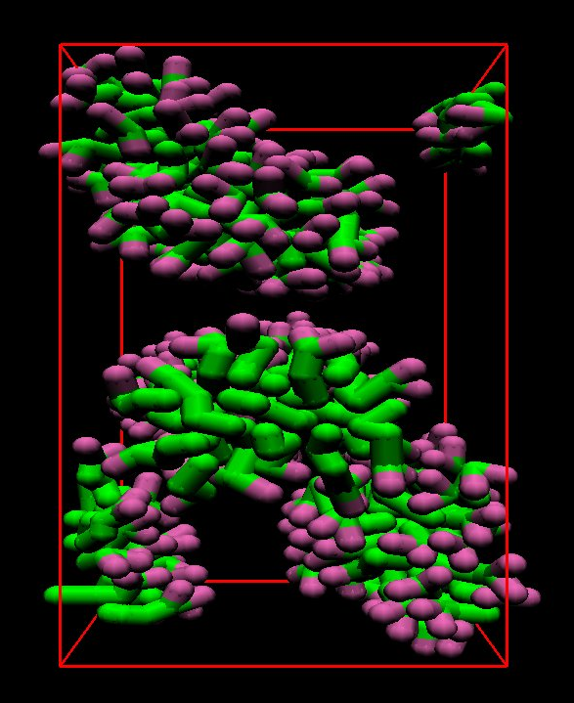
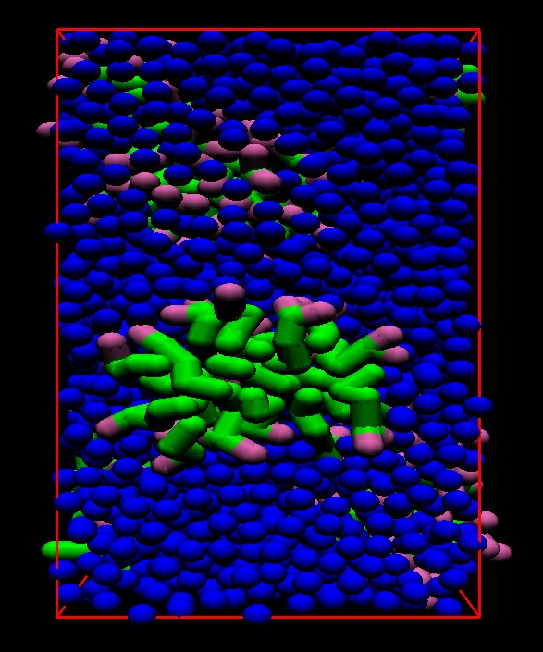
Molecular simulation for 2 Headed surfactant

Slide 17
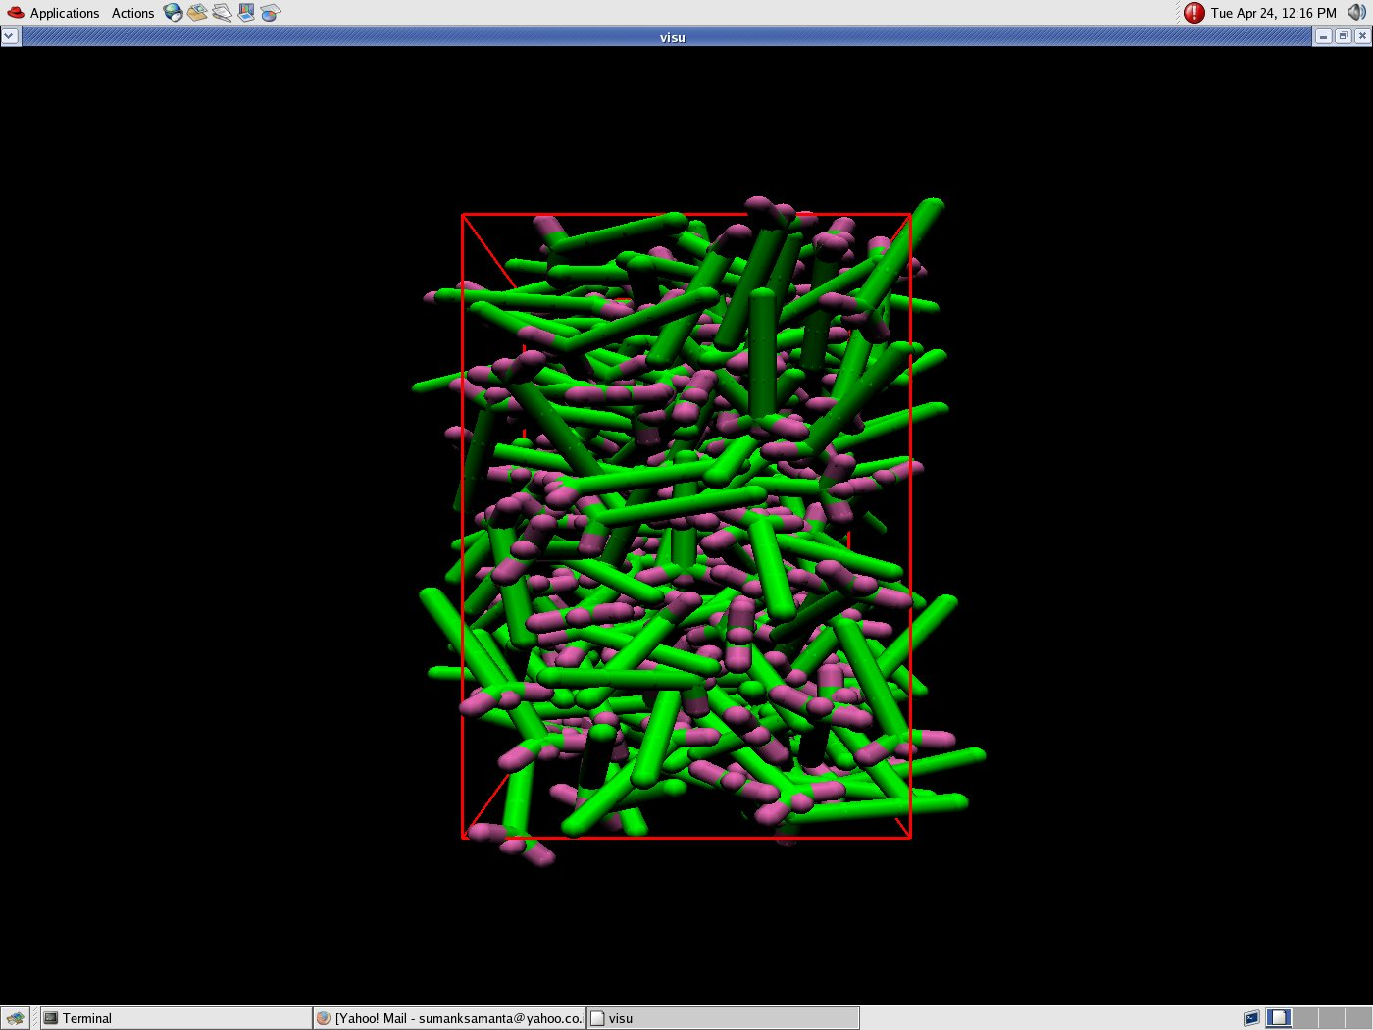
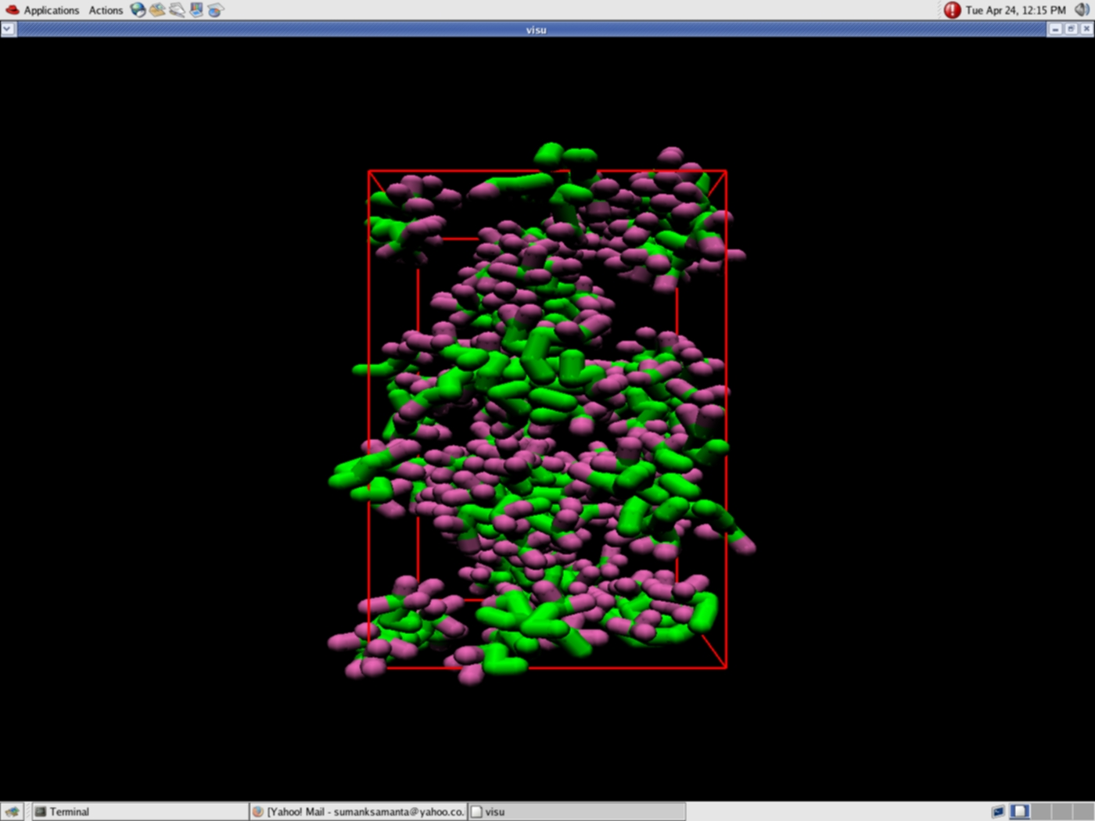
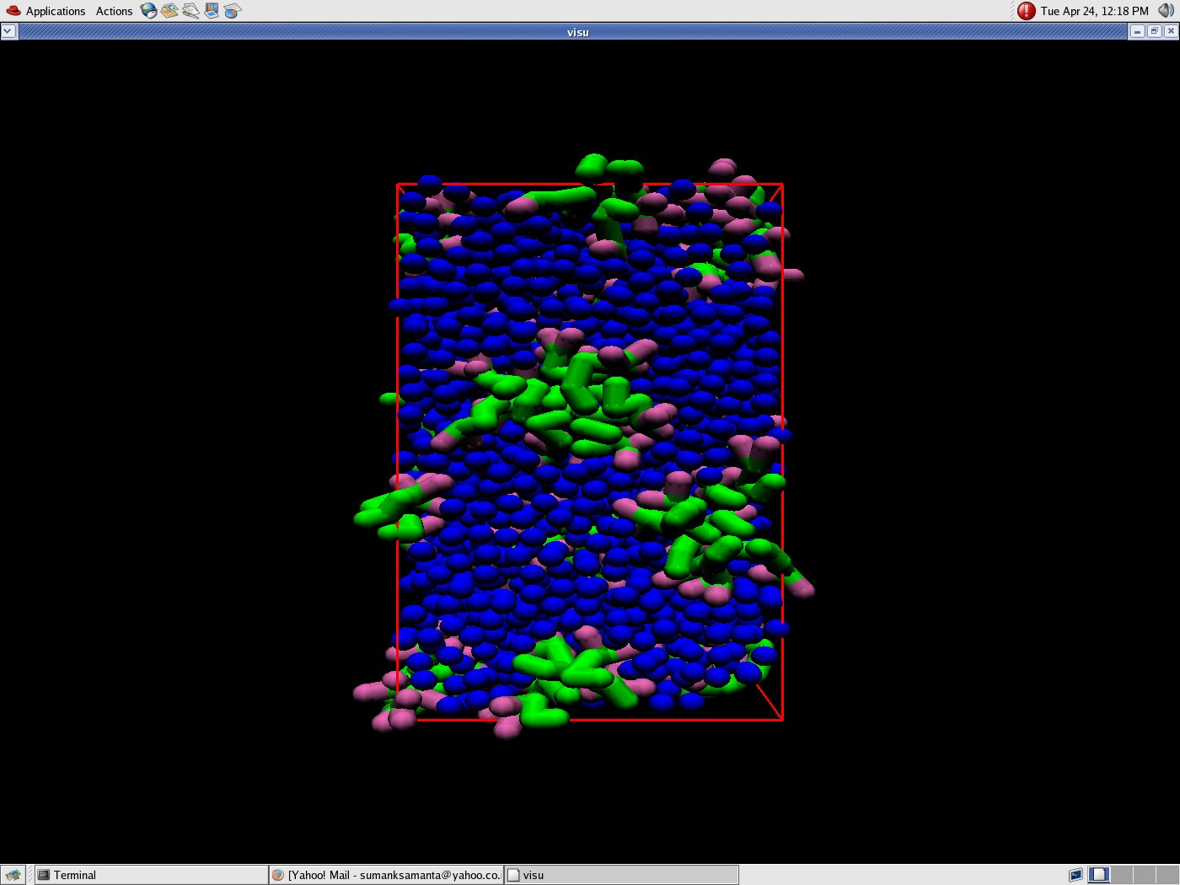
Molecular simulation for 3 Headed surfactant

Slide 18
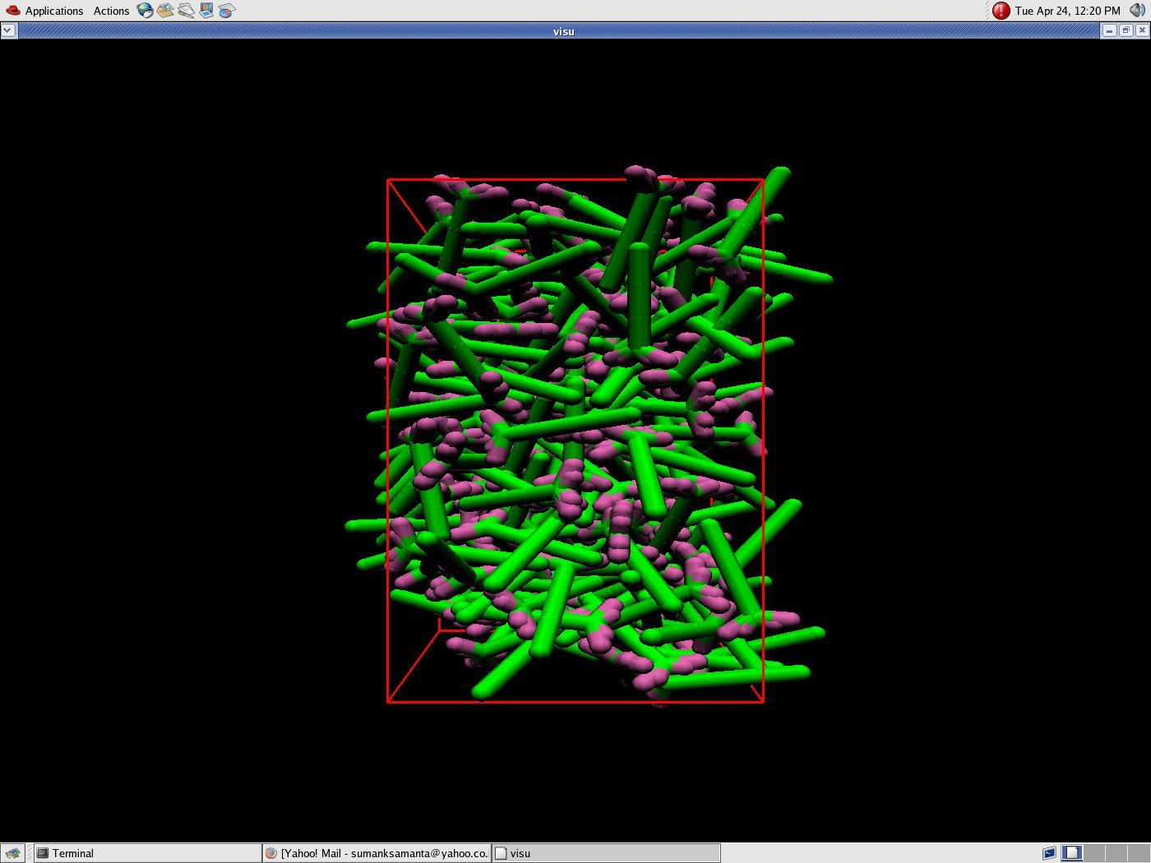
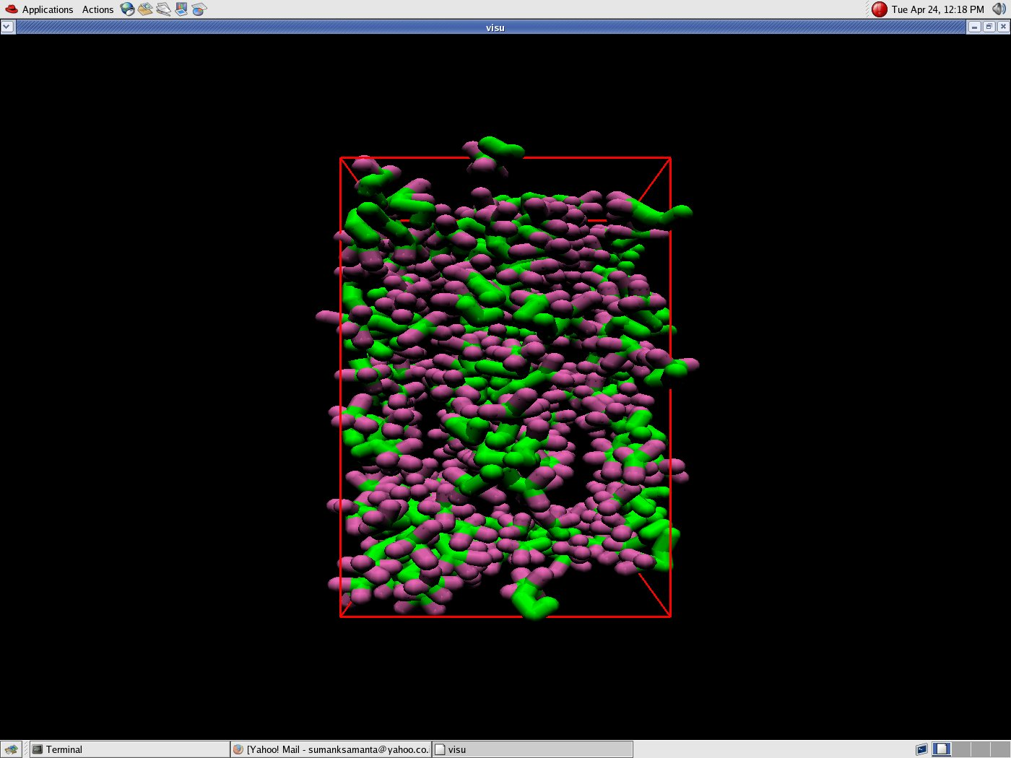
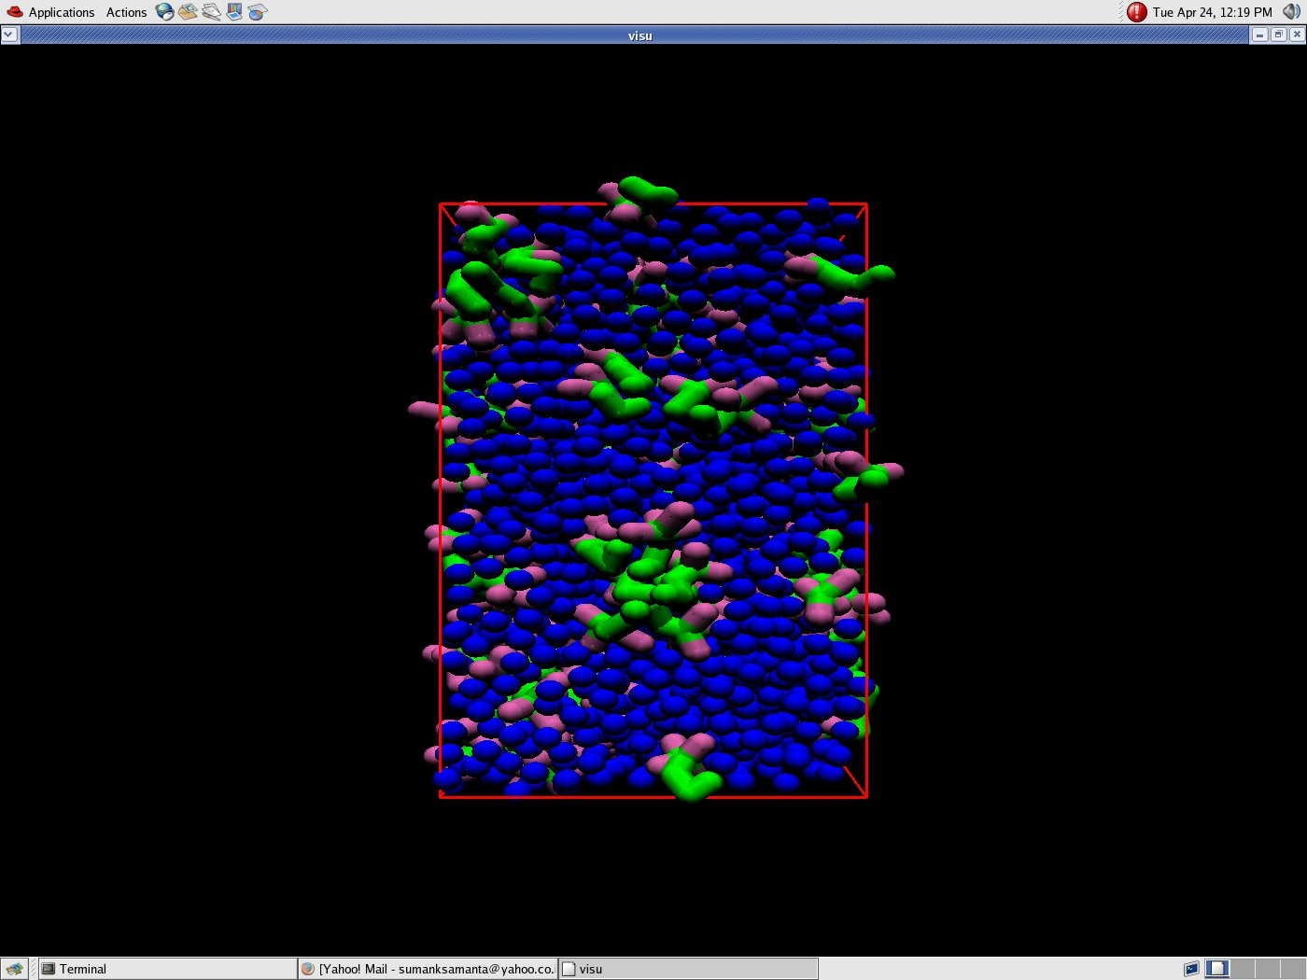
Molecular simulation for 4 Headed surfactant

Slide 19
Comparison
3 Head
4 Head
2 Head

Slide 20
Conclusion
Aggregation Property varies as-
2 Headed surfactant > 3 Headed surfactant > 4 Headed surfactant
CMC varies as-
2 Headed surfactant < 3 Headed surfactant < 4 Headed surfactant

Slide 21
References
A.F. de Moura, L.C.G. Freitas / Chemical Physics Letters 411 (2005) 474–478
From course work materials

Slide 22
Acknoledgement
Dr. Prabal Maiti
Arun Kumar
All my Friends

Slide 23
Thank You

